Slide 1


B.Tech Minor Project II Presentation
Yoga Mitra
An AI-powered real-time yoga posture detection and correction system that analyses body key points and joint
alignment to identify errors and provide personalized corrective feedback.
Presented By :
Om Patil (112415145), Vidhansh Soni(112415234)
Aditi Thakre(112415010) , Divyanshu Gupta(112415061)
Project supervisor :
Dr. Chandrakant Guled
01

Slide 2
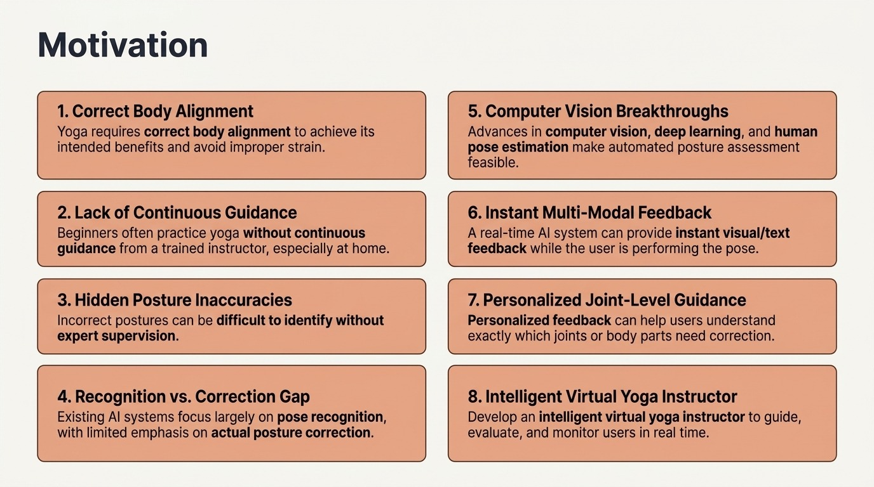
02

Slide 3
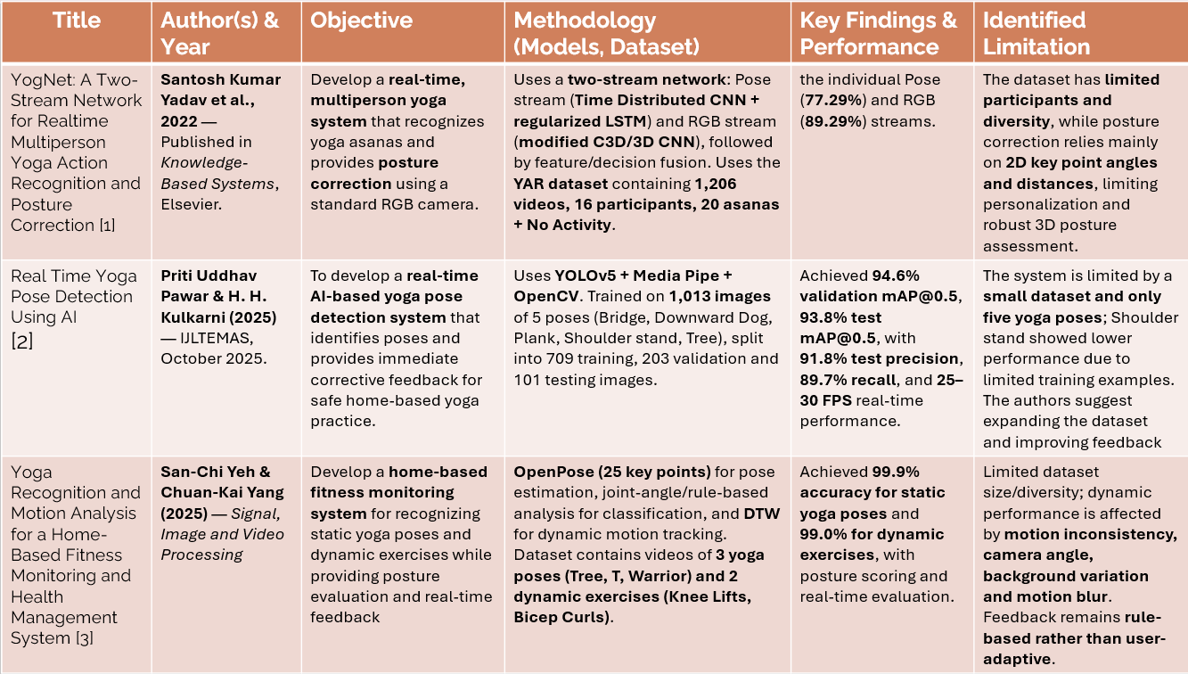
03

Slide 4
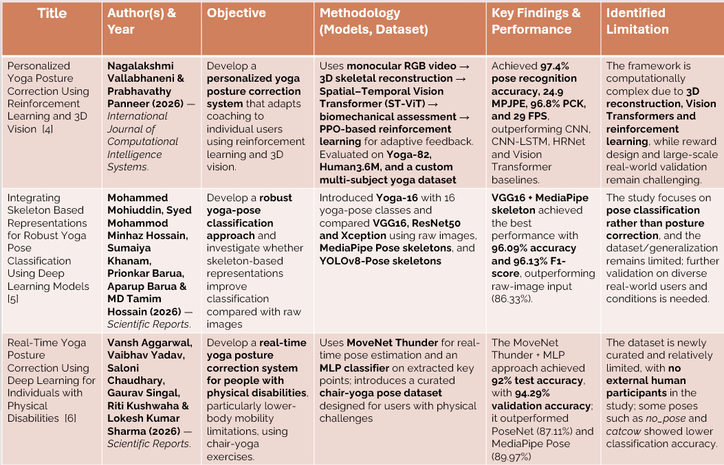
04

Slide 5
Research Gap –1 : Fixed Posture Standards
Existing Approach
Proposed Solution
Most existing systems evaluate yoga posture using predefined joint-angle thresholds or universal reference poses.
The same target range is applied to every user, even though people naturally differ in:
  Height and body proportions
  Limb lengths
  Flexibility
  Mobility
  Natural joint-angle ranges
Therefore, a deviation considered incorrect for one user may be normal or unsuitable for another.
User-Specific Biomechanical Baseline
A short calibration phase learns the user’s :
  Body proportions
  Joint-angle patterns
  Individual reference ranges
Personalized Correction :
The current posture is compared with the user's baseline to determine the deviation and generate a personalized correction.
KEY CONTRIBUTION :
Replace universal posture thresholds with personalized, body-adaptive joint-angle ranges.
05

Slide 6



Research Gap –2 : Recognition ≠ Correction
EXISTING SYSTEMS
LIMITATION
PROPOSED APPROACH
Most existing yoga systems focus mainly on recognizing or classifying the yoga pose rather than analysing the quality of its execution.
Pose recognition
correct/incorrect
Pose recognition alone does not provide detailed information about the posture error.
It cannot determine:
Which joint is misaligned, How much the joint deviates, How severe the error is, What correction the user should perform
Joint-level posture analysis goes beyond simply recognizing the yoga pose.
The system analyses:
Camera Input, Pose Estimation, Joint-Level Analysis, Deviation Magnitude, Error Severity, Specific Correction
Generic Feedback:
“Pose Incorrect”
Specific Feedback:
Right Knee — Misaligned
Deviation: X°
Severity: Moderate
Correction: Move your right knee slightly inward.
06

Slide 7
Research Gap –3 Unreliable Real-World Feedback
Real-World Challenges
Pose estimation can become unreliable due to:
  Self-occlusion
  Poor lighting
  Motion blur / sudden movement
  Unusual camera viewpoints
  Partially visible body joints
This is directly supported by our literature review, which identifies self-occlusion, unusual viewpoints, motion blur and poor illumination as sources of uncertainty.
Proposed Approach: Confidence-Aware Feedback
Instead of blindly correcting every detected error, combine:
  Landmark Confidence
  Confidence of detected body landmarks
  Temporal Stability
  Consistency of the landmark across frames
  Joint Visibility
  Whether the relevant body joint is clearly visible
High
Provide Correction
Medium
Limited/ Soft Feedback
Low
Suppress Correction and Reposition
Reliability
Assessment
07

Slide 8
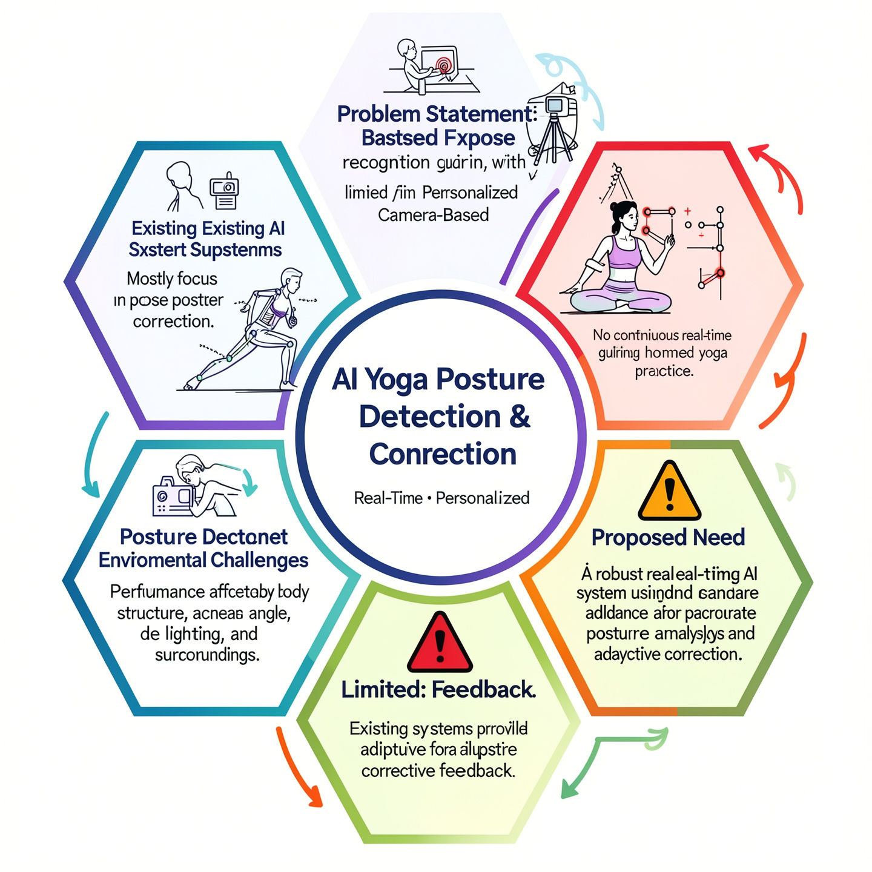
Problem Statement :-
Existing yoga AI systems mainly focus on pose recognition, not personalized correction.
Lack of real-time expert supervision makes home-based practice challenging.
Difficulty in detecting joint misalignment and posture deviations accurately.
Performance can vary with body structure and environmental conditions.
Existing systems provide limited adaptive and personalized feedback.
Therefore, a robust real-time AI system is needed for accurate posture analysis.
The system should provide adaptive corrective feedback using a standard camera.
08

Slide 9
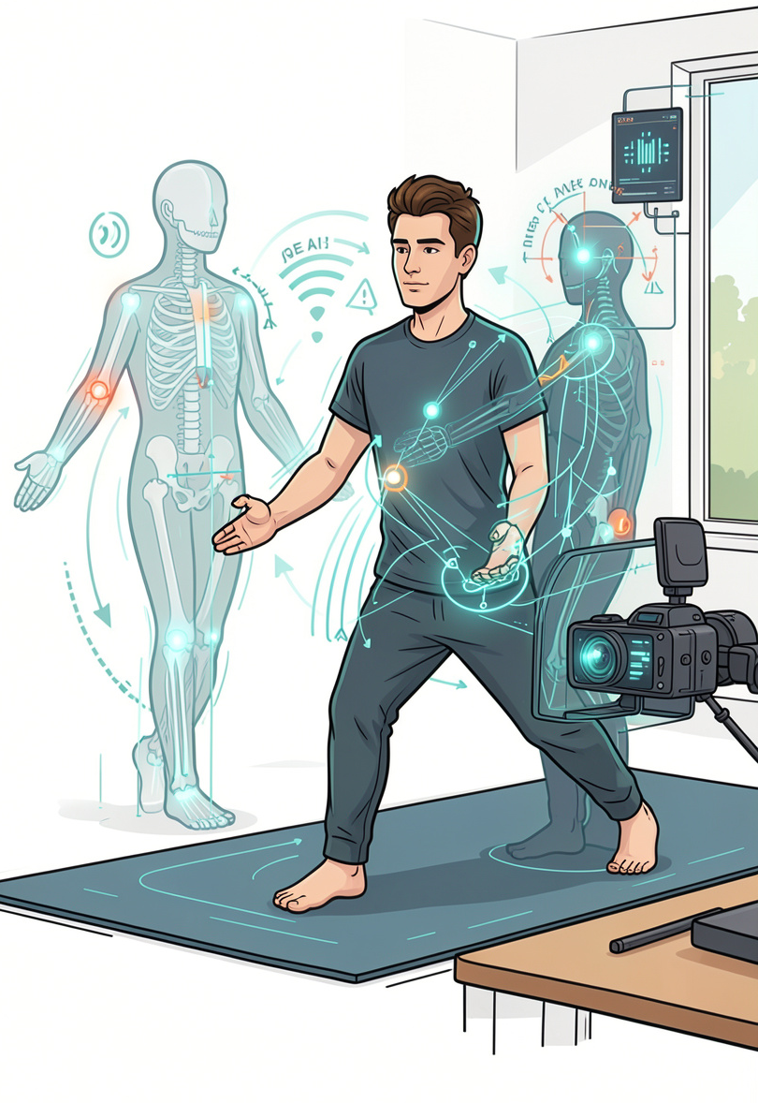




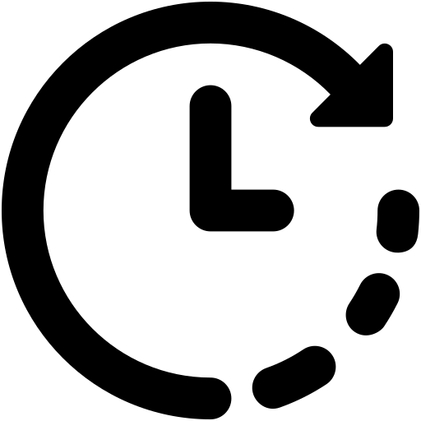
Proposed Solution :-
1. Personalized Assessment
Calibrate for body proportions and joint structure.
Establish a user-specific posture baseline.
2. Robust Pose Representation
Extract normalized key points, angles, and alignment features.
Handle variations in body size, viewpoint, lighting, and occlusion.
3. Joint-Level Error Detection
Detect misaligned joints and deviation severity.
Use landmark confidence and temporal stability for reliable results.
4. Adaptive Multimodal Feedback
5. Real-Time Evaluation
Provide visual, text, and voice-based corrections.
Adapt feedback according to user performance and progress.
Ensure low latency and high FPS on consumer hardware.
Evaluate accuracy, correction quality, robustness, false alarms, and latency.
09

Slide 10
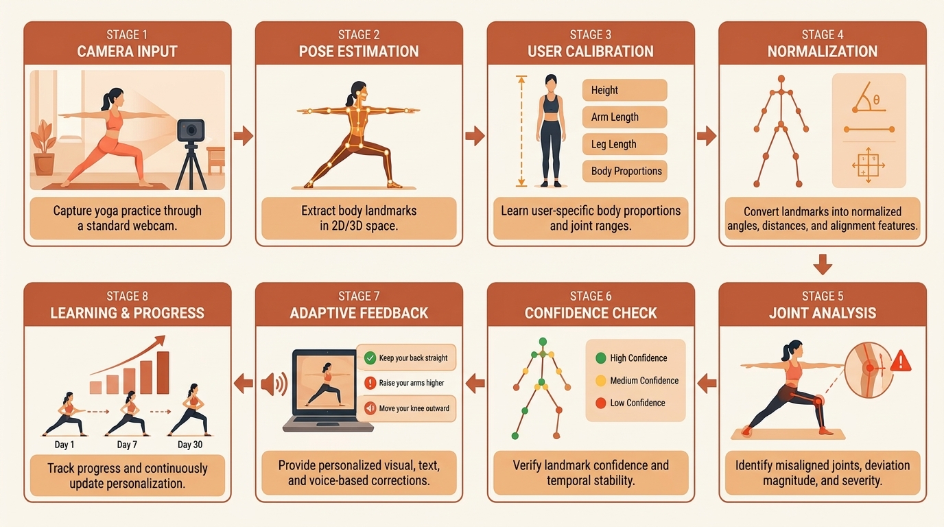
Methodology for Yoga Correction and Detection
10

Slide 11
Project Roadmap
From raw pose data to real-time correction and personalized progress
01
Pose Estimation &
Landmark Extraction
02
Pose Recognition
03
Alignment Analysis
04
Error Detection
05
Real-Time Feedback
& Visualization
• Capture live video from camera
• Detect person in frame
• Extract body landmarks
• Calculate joint angles and relative distances
• Normalize keypoints
• Use extracted features (angles, distances, keypoints)
• Train ML model (Random Forest / SVM)
• Predict the yoga pose with confidence score
• Define ideal joint angle ranges for each pose
• Compare user angles with reference values
• Detect misalignments and measure deviations
• Create pose-specific error rules
• Identify incorrect joints and posture mistakes
• Classify severity (light / moderate / major)
• Map errors to corrective suggestions
• Display live camera feed with skeleton overlay
• Highlight incorrect joints/angles
• Provide real-time textual instructions
• Generate overall pose score
›
›
›
›
Output: Body landmarks & joint angles
Output: Detected pose & confidence score
Output: Alignment score & deviation metrics
Output: Detected errors with correction hints
Output: Real-time coaching interface
06
Progress Tracking & Personalization
• Store session history
• Track pose-wise performance
• Identify recurring mistakes
• Show improvement trends
• Provide personalized recommendations
07
Testing, Evaluation & Deployment
• Test with different users, lighting and backgrounds
• Measure model accuracy and real-time performance (FPS, latency)
• Fix edge cases and optimize for robustness
• Prepare final prototype for demonstration
Output: User progress insights & personalized tips
POSE DETECTION
→
POSTURE UNDERSTANDING
→
REAL-TIME CORRECTION
→
PERSONALIZED IMPROVEMENT
11

Slide 12
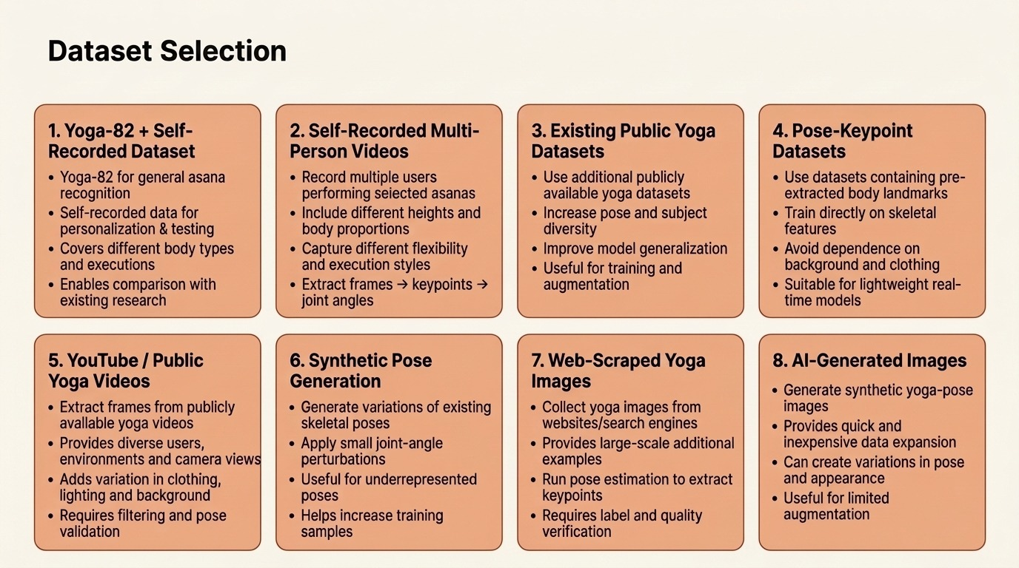
12

Slide 13
Dataset Preprocessing
Metadata Preprocessing
Image/Video Collection:
Frame Extraction
Pose Estimation
Keypoint Filtering
Normalization
Feature Extraction
Data Augmentation
Labeling
Metadata Collection
Data Cleaning
Missing Values
Categorical Encoding
Normalization
Label Verification
Outlier Detection
Dataset Splitting
13

Slide 14
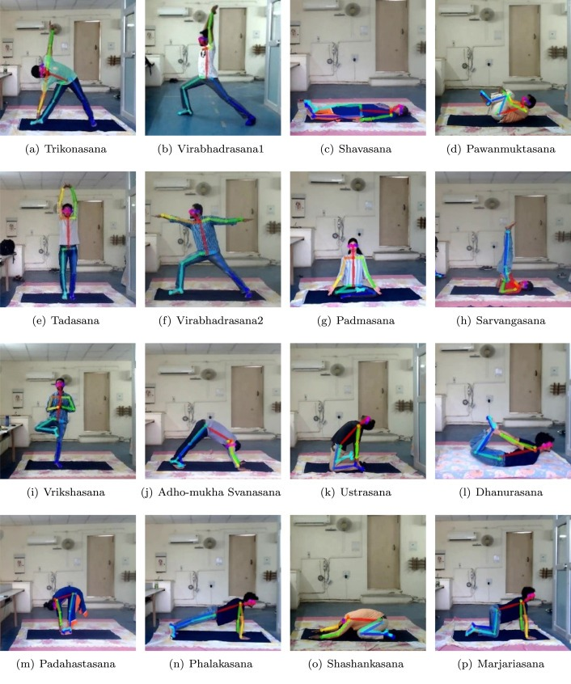
Fig. Postures of yoga asanas considered in this paper [2]
YogNet: A Two-Stream Network for Realtime Multi person Yoga Action Recognition and Posture Correction” by S. K. Yadav, A. Agarwal, A. Kumar, K. Tiwari, H. Pandey, and S. A. Akbar, published in Knowledge-Based Systems, 2022, Volume 250, Article 109097
14

Slide 15
Training Strategy
Dataset Split Train, validation and test sets
Transfer Learning: Used pretrained model
Fine-Tuning Unfroze top layers for fine-tuning with low learning rate
Loss Function : Categorical cross-entropy
Optimizer : Adam with learning rate scheduling
Regularization : Dropout & early stopping to reduce overfitting
Metrics Tracked : Accuracy, precision, recall
Evaluation Metrics
F1 Score
ROC Curve & AUC
Confusion Matrix
15

Slide 16




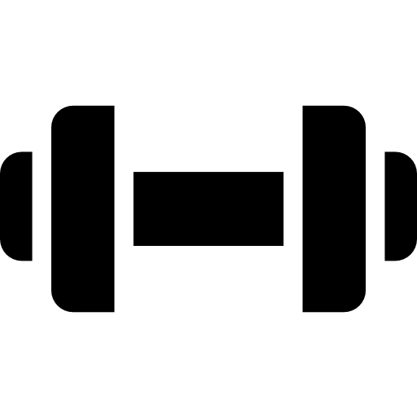

Real World Application
Home-Based Yoga Training Provides real-time posture guidance without requiring a physical instructor.
Virtual Yoga Instructor – Provides automated pose evaluation and corrective feedback during practice.
Mobile & Web Applications – Enables camera-based yoga assessment using smartphones, laptops, or webcams.
Physiotherapy Rehabilitation Assists patients in performing prescribed movements with proper body alignment.
Fitness & Wellness Platforms – Integrates posture correction into AI-powered fitness applications.
Remote/Online Yoga Classes – Enables instructors or platforms to monitor users remotely through AI-based pose analysis.
16

Slide 17
Research and References :-
[1] YogNet. Yadav, S. K., Agarwal, A., Kumar, A., Tiwari, K., Pandey, H. M., & Akbar, S. A. (2022). YogNet: A two-stream network for realtime multiperson yoga action recognition and posture correction. Knowledge-Based Systems, 250, 109097. https://doi.org/10.1016/j.knosys.2022.109097
[2] Real Time Yoga Pose Detection Using AI. Pawar, P. U., & Kulkarni, H. H. (2025). Real Time Yoga Pose Detection Using AI. International Journal of Latest Technology in Engineering Management & Applied Science, 14(10), 151–155. https://doi.org/10.51583/IJLTEMAS.2025.1410000020
[3] Yeh, S.-C., & Yang, C.-K. (2025). Yoga pose recognition and motion analysis for a home-based fitness monitoring and health management system. Signal, Image and Video Processing. https://doi.org/10.1007/s11760-025-04436-6​
[4] Vallabhaneni, N., & Panneer, P. (2026). Reinforcement learning-driven adaptive coaching using 3D vision transformers for personalized yoga pose correction. International Journal of Computational Intelligence Systems. https://doi.org/10.1007/s44196-026-01494-7 ​
[5] Mohiuddin, M., Hossain, S. M. M., Khanam, S., Barua, P., Barua, A., & Hossain, M. D. T. (2026). Integrating skeleton based representations for robust yoga pose classification using deep learning models. Scientific Reports, 16, 22144. https://doi.org/10.1038/s41598-025-23726-0
​
​
17

Slide 18
Research and References :-
[6] Real-Time Yoga Posture Correction Using Deep Learning for Individuals with Physical Disabilities. Aggarwal, V., Yadav, V., Chaudhary, S., Singal, G., Kushwaha, R., & Sharma, L. K. (2026). Real-time yoga posture correction using deep learning for individuals with physical disabilities. Scientific Reports. ​https://doi.org/10.1038/s41598-026-54280-y
[7] Aggarwal, V., Yadav, V., Chaudhary, S., Singal, G., Kushwaha, R., & Sharma, L. K. (2026). Real-time yoga posture correction using deep learning for individuals with physical disabilities. Scientific Reportshttps://doi.org/10.1038/s41598-026-54280-y ​
[8] Ashok, A., Surendiran, B., & Babu, S. (2025). Yoga pose estimation using MoveNet deep learning models. Sādhanā. https://doi.org/10.1007/s12046-025-02788-w​
18

